Slide 1
120 GHz Imaging Radar
Group 40 – sdmay40-24
Aaron McCarville
Benjamin Podjenski
Huyen Vy Pham
Gunnar Hageman
Noah Gaffney
Client/ Advisor: Professor Mohammad Tayeb Al Qaseer

Slide 2
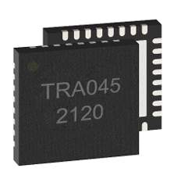
Project Vision
Project goal: It is to build a 120 GHz millimeter wave (mm-wave) imaging radar. The system will be based on TRA_120_045 radar chip. There are three subsystems in the radar:
Radio Frequency (RF) circuit (radar IC and phased-locked-loop (PLL) circuitry).
ADC circuit with FPGA
A GUI
Usage:
It is mainly used at the Center for Non-destructive Evaluation do object imaging and flaw detection inside of model.
Approach:
Building and testing two subsystems (RF and ADC boards) separately.
Programming the Alchitry Au to control peripheral IC's through SPI.
Configuring the Alchitry Au to send ADC data to Host PC via USB.
Building a PC application for user to communicate to the system.
Testing the system for functionality.
Using the system to conduct radar imaging experiments in the microwave lab at CNDE.
1

Slide 3
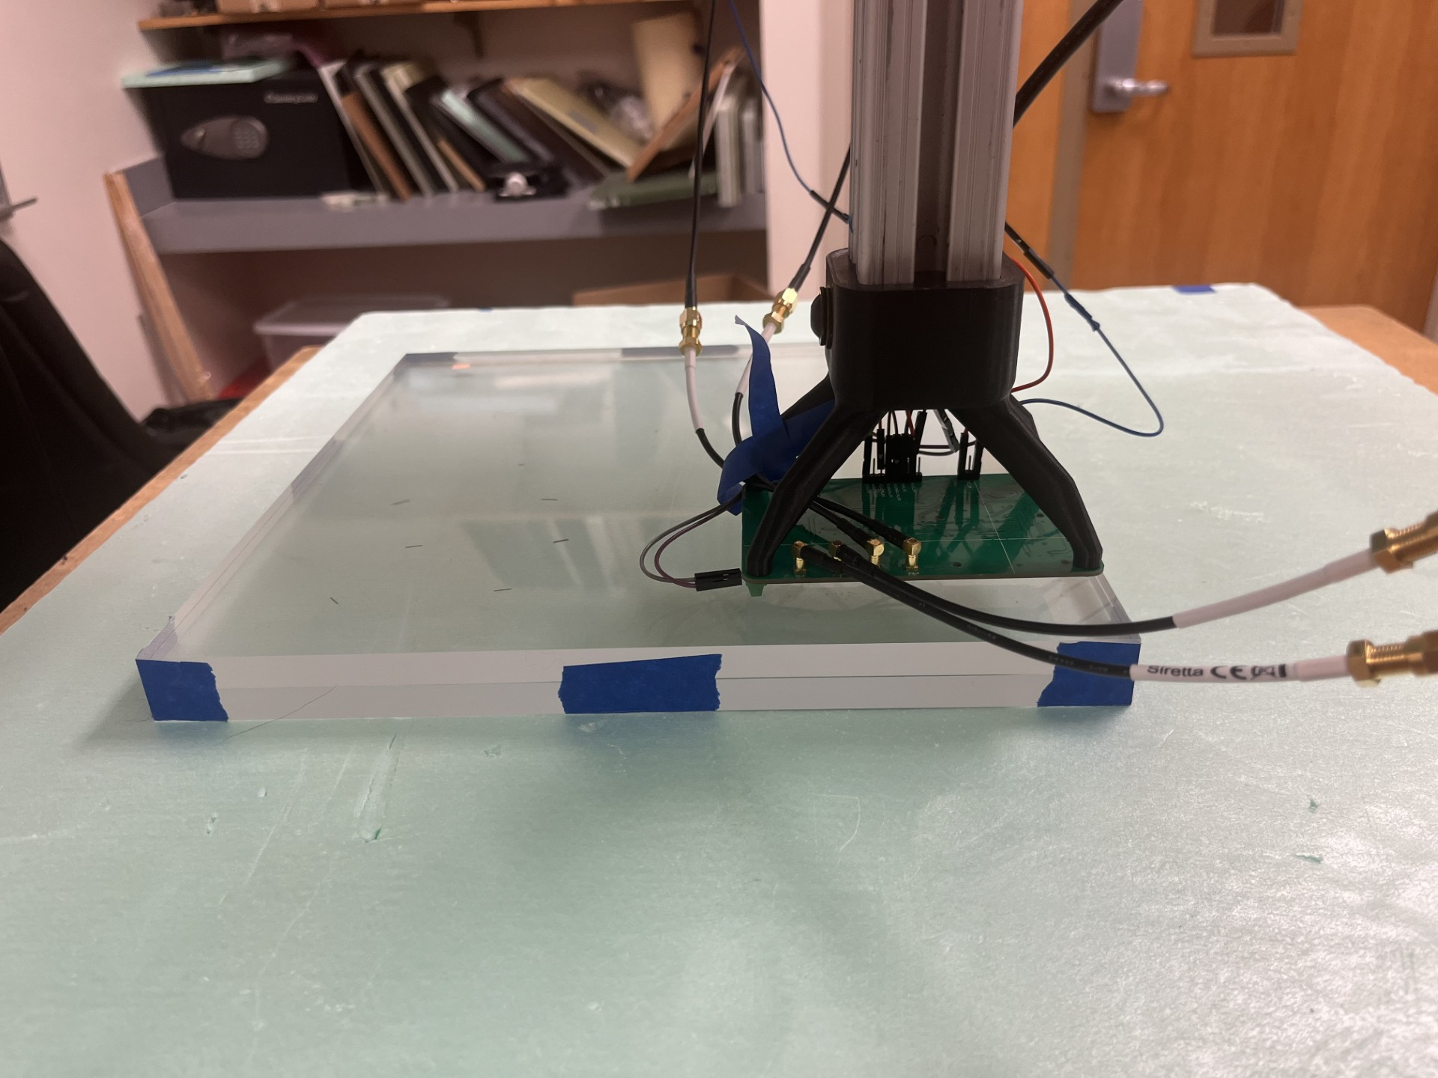
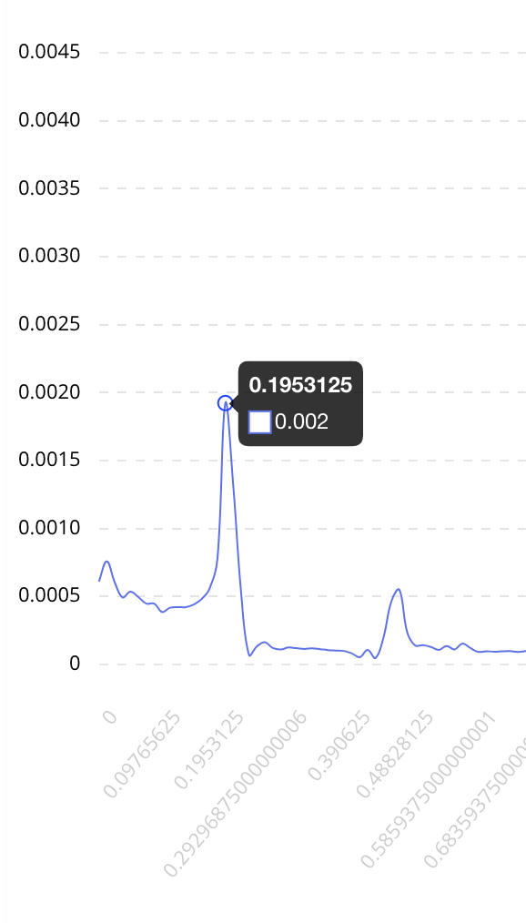
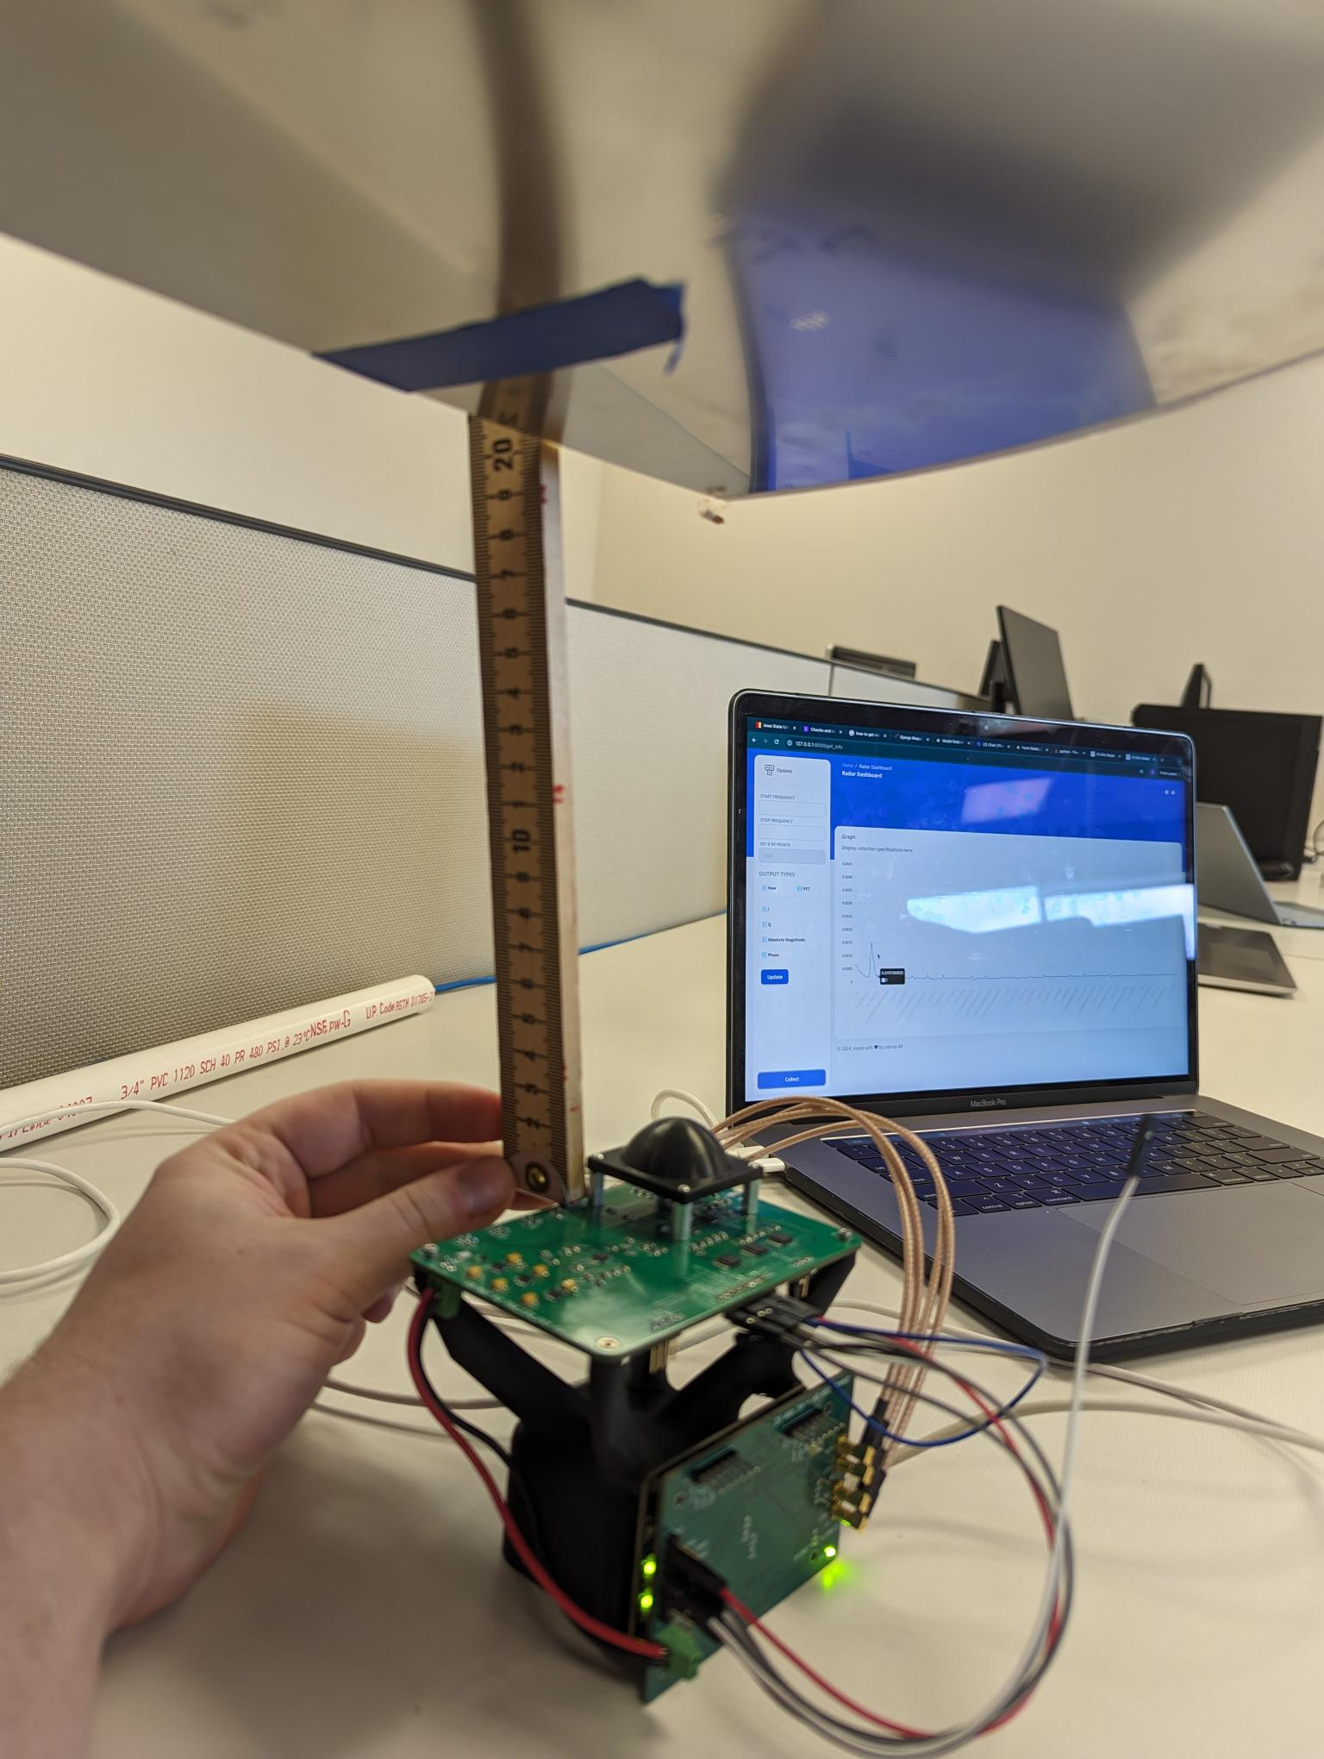
Project Vision (cont.)
2

Slide 4
Conceptual/Visual Sketch
RF Board: Radar IC and PLL circuitry
FPGA Board: SPI, UART, and FTDI/ USB communication
Control signal
Control signal
User Interface: Data transfer and display; control signal
Data
ADC Board: Low Pass Filter, Amplifier, and ADC
Control Signal
Data
Data
3

Slide 5
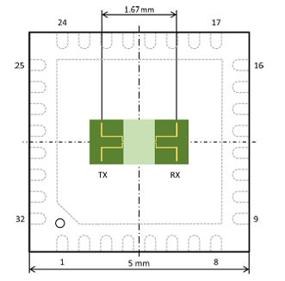
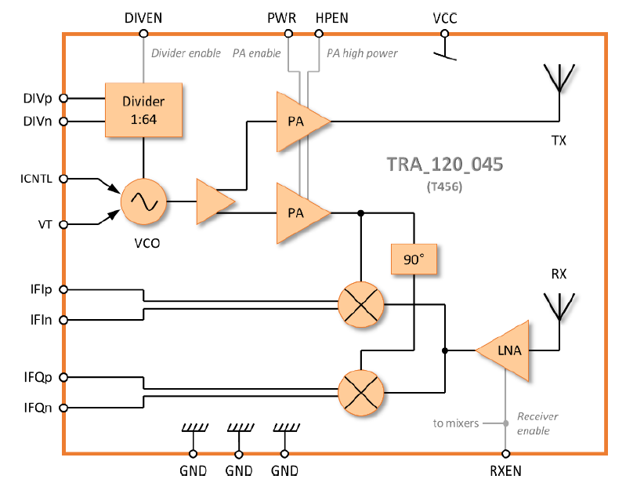
System Design a) TRA_045 chip
It is an integrated wideband transceiver circuit with antennas on chip.
Frequency range: 113.9 GHz to 134.1 GHz
It is can be used in frequency modulated continuous wave (FMCW) radar operation or continuous wave (CW) mode.
4

Slide 6
System Design b) Radio Frequency Board
IFIn, IFIp
IFQn, IFQp
SPI
50 MHz Reference clock signal
Phase Lock Loop IC
Radar IC (TRA_045)
Divided Signal
V_tune, I_control
Note:
V_tune and I_control are used for tuning the output to be the right frequency that will be emitted from the Radar IC
IFIn, IFIp: Differential pairs of Intermediate Frequency I signal (Real part of the data)
IFQn, IFQp: Differential pairs of Intermediate Frequency Q signal (Imaginary part of the data)
5

Slide 7
System Design c) ADC Board
IFIp
ADC
Amplifier
LPF
IFI
IFIn
IFQp
ADC
Amplifier
LPF
IFQ
IFQn
Amplifier is a SPI configurable amplifier with gain from 0.2V/V to 157V/V.
ADC is a 2-channel 16-Bit, 2Msps, Dual Simultaneous Sampling SAR ADC.
6

Slide 8
System Design d) Signal Path
RF Board
Alchitry Au
SPI
ARTIX 7
Control signal
UART
Host PC
IFI and IFQ data / Control
FTDI Chip
Control
GUI
IFI and IFQ data
ADC Board
Control signal
UART
IFI and IFQ
JTAG
IFI and IFQ data
7

Slide 9
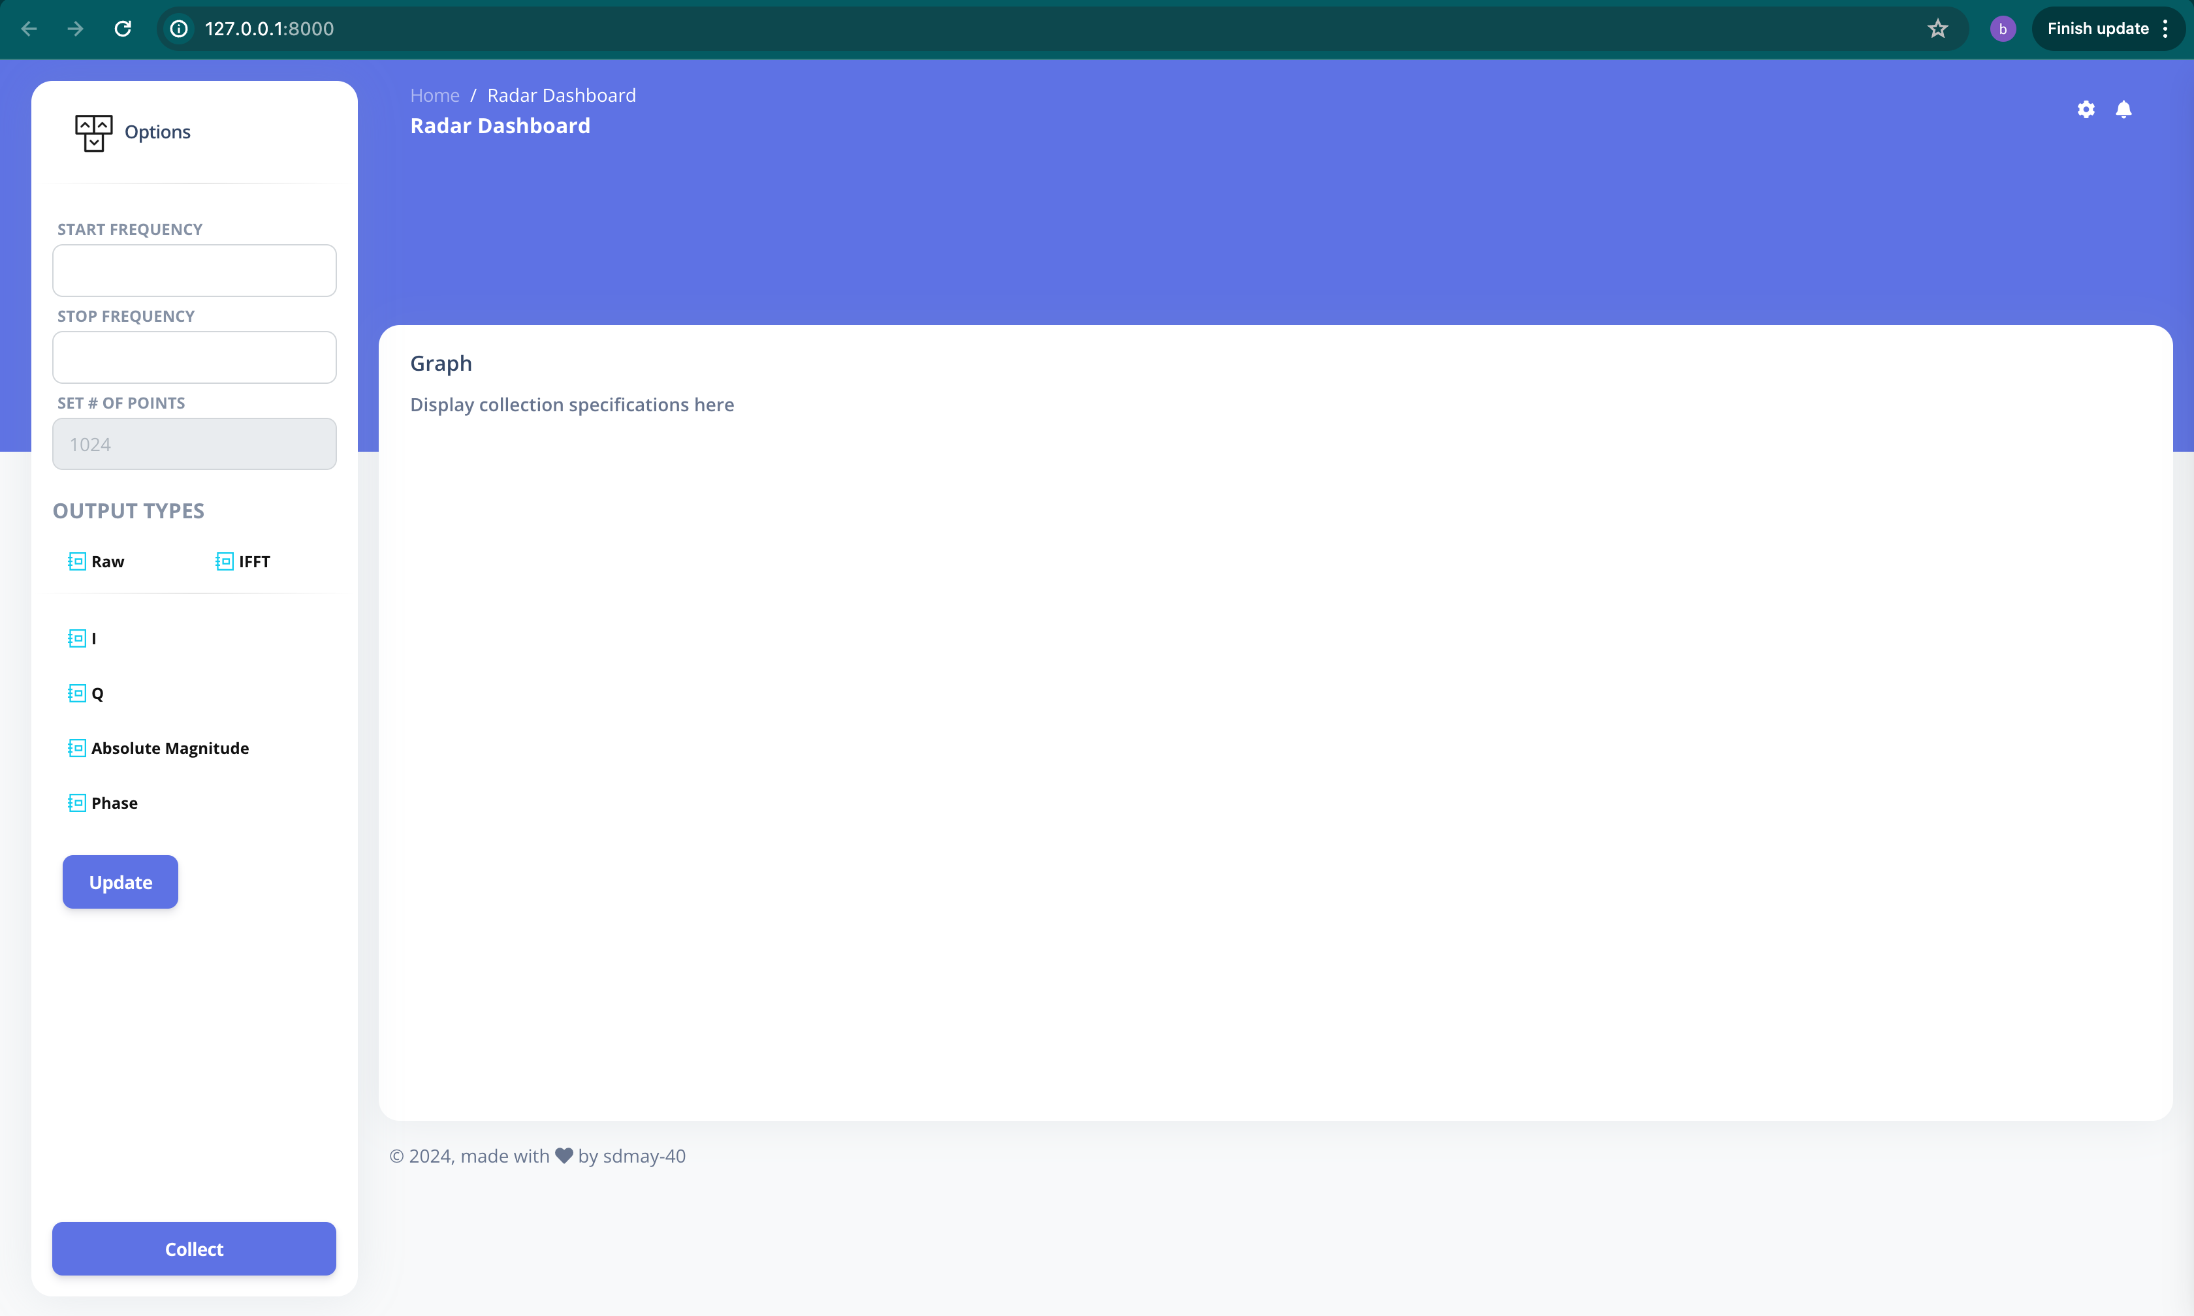
System Design e) User Interface
FPGA
Control signal
Raw Data (IFI and IFQ)
8

Slide 10
System Design f) HW/SW platforms, technology, frameworks, standards
GUI software:
Front-end: Django Framework.
Back-end: Python
Embedded Programming: Xilinx platform, Vivado (Hardware) and Vitis (Software).
RF and ADC board Design: KiCad.
Lens Modeling: CST software.
Testing: Spectrum Analyzer, Oscilloscope, MicroVis3D (Synthesis Aperture Radar – SAR)
9

Slide 11
Design Complexity
Our design contains multiple components and subsystems that each require different engineering skills, such as circuit design, embedded programming, and software programming.
Design iterations: Design each subsystem and test to collect results and problems. Based on the testing result, the subsystem is adjusted.
RF PCB Design:
Complex circuit design, signal reception and processing, data transfer
ADC PCB Design: Programming the ADC configuration and data acquisition.
FPGA Programming: Programming the FPGA for data processing from the ADC board, and for communicating through SPI with ADC and the PLL chip.
GUI Programming: for data processing, signal control, and data display in Python.
10

Slide 12
Project Plan
Testing with benchtop DAQ
Final Product
RF board
FPGA Programming
ADC board
FPGA Research and Learning
GUI Programming
11

Slide 13
Test Plan
a) Unit Testing
RF Board:
The board is powered up correctly.
The PLL can be programmed through FTDI cables and is locked at a frequency.
It can sweep a full range of frequencies. The spectrum analyzer is used to detect the range of frequency.
ADC Board:
The board is powered up correctly.
A signal generator will send a voltage sine wave is sent to the ADC board. The raw ADC data is collected by the FPGA and is plotted by the host to be compared to the original voltage sine wave.
FPGA:
FPGA is programmed to communicate with the RF board or with the ADC board exclusively when it is specified by the operator.
FPGA can receive the voltage data (from sub section 2 above) and the user can access the raw ADC data
GUI:
Test the data display functionality.
Test communication between the PC (GUI) and the FPGA.
12

Slide 14
Test Plan (cont.)
b) Interface Testing
Testing different parts of the design as a pair to check the operability of each unit with each other.
E.g.: Test the RF board with the ADC board, test the ADC board with the FPGA, etc.
c) System Testing
System testing requires the interoperability between different components in the system (ADC, RF, FPGA and UI).
It also requires the data transmitting and receiving between different parts of the system.
d) Acceptance Testing
Detect object’s distance using the IFFT data from the webpage.
Conduct object’s imaging (which has known structure) at the CNDE.
13

Slide 15
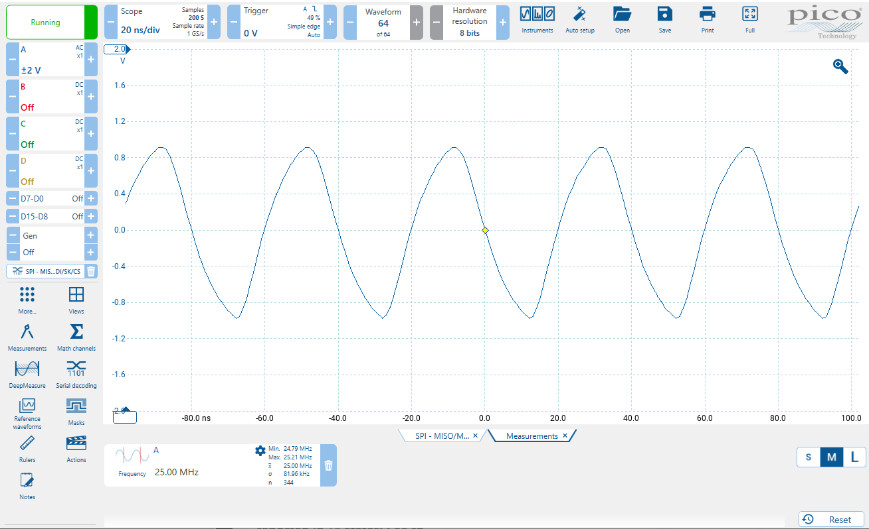
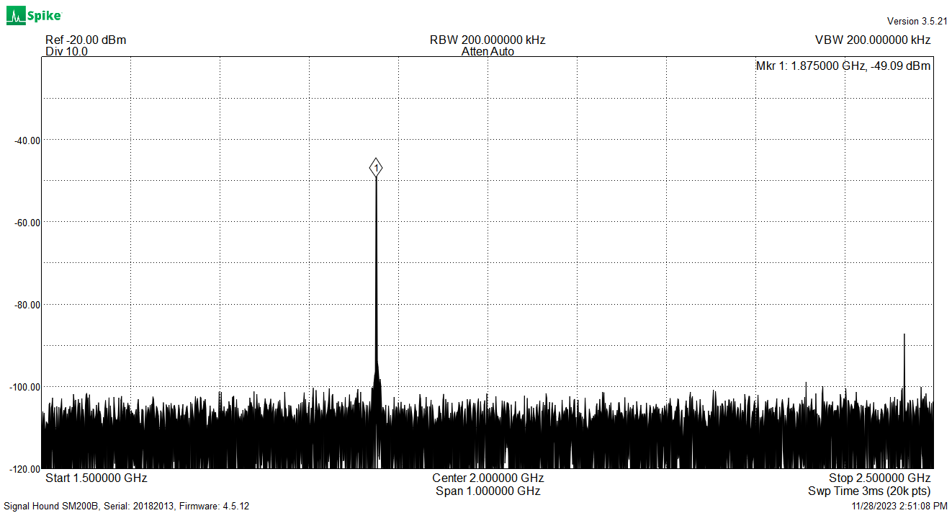
Test Results
RF board:
a) Programmed MUXOUT on PLL to output R-divider signal. Correct output is 25MHz. This is used to verify that the PLL can be programmed to have the correct output.
b) Div-p and Div-n Radar chip outputs are probed with the spectrum analyzer. PLL is programmed to set the Radar frequency to 120 GHz. Expected 1.875 GHz on the Div-p and Div-n outputs.
Test result for test a)
Test result for test b)
14

Slide 16
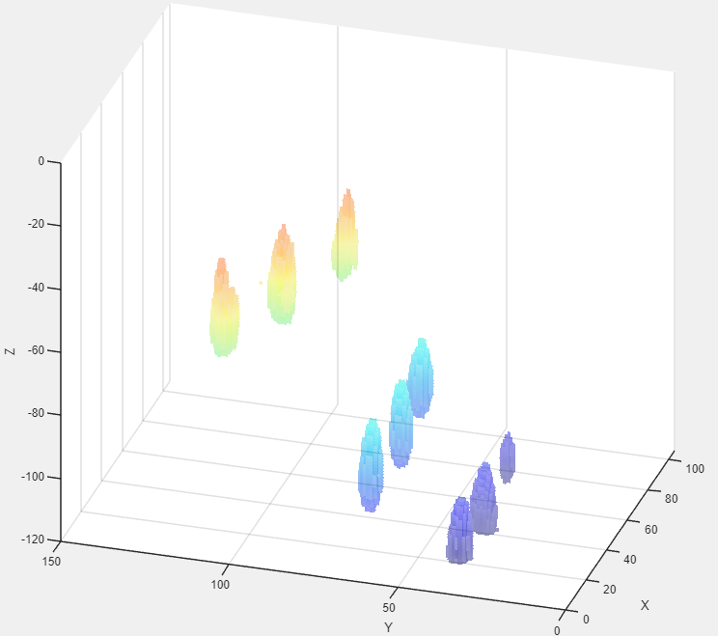
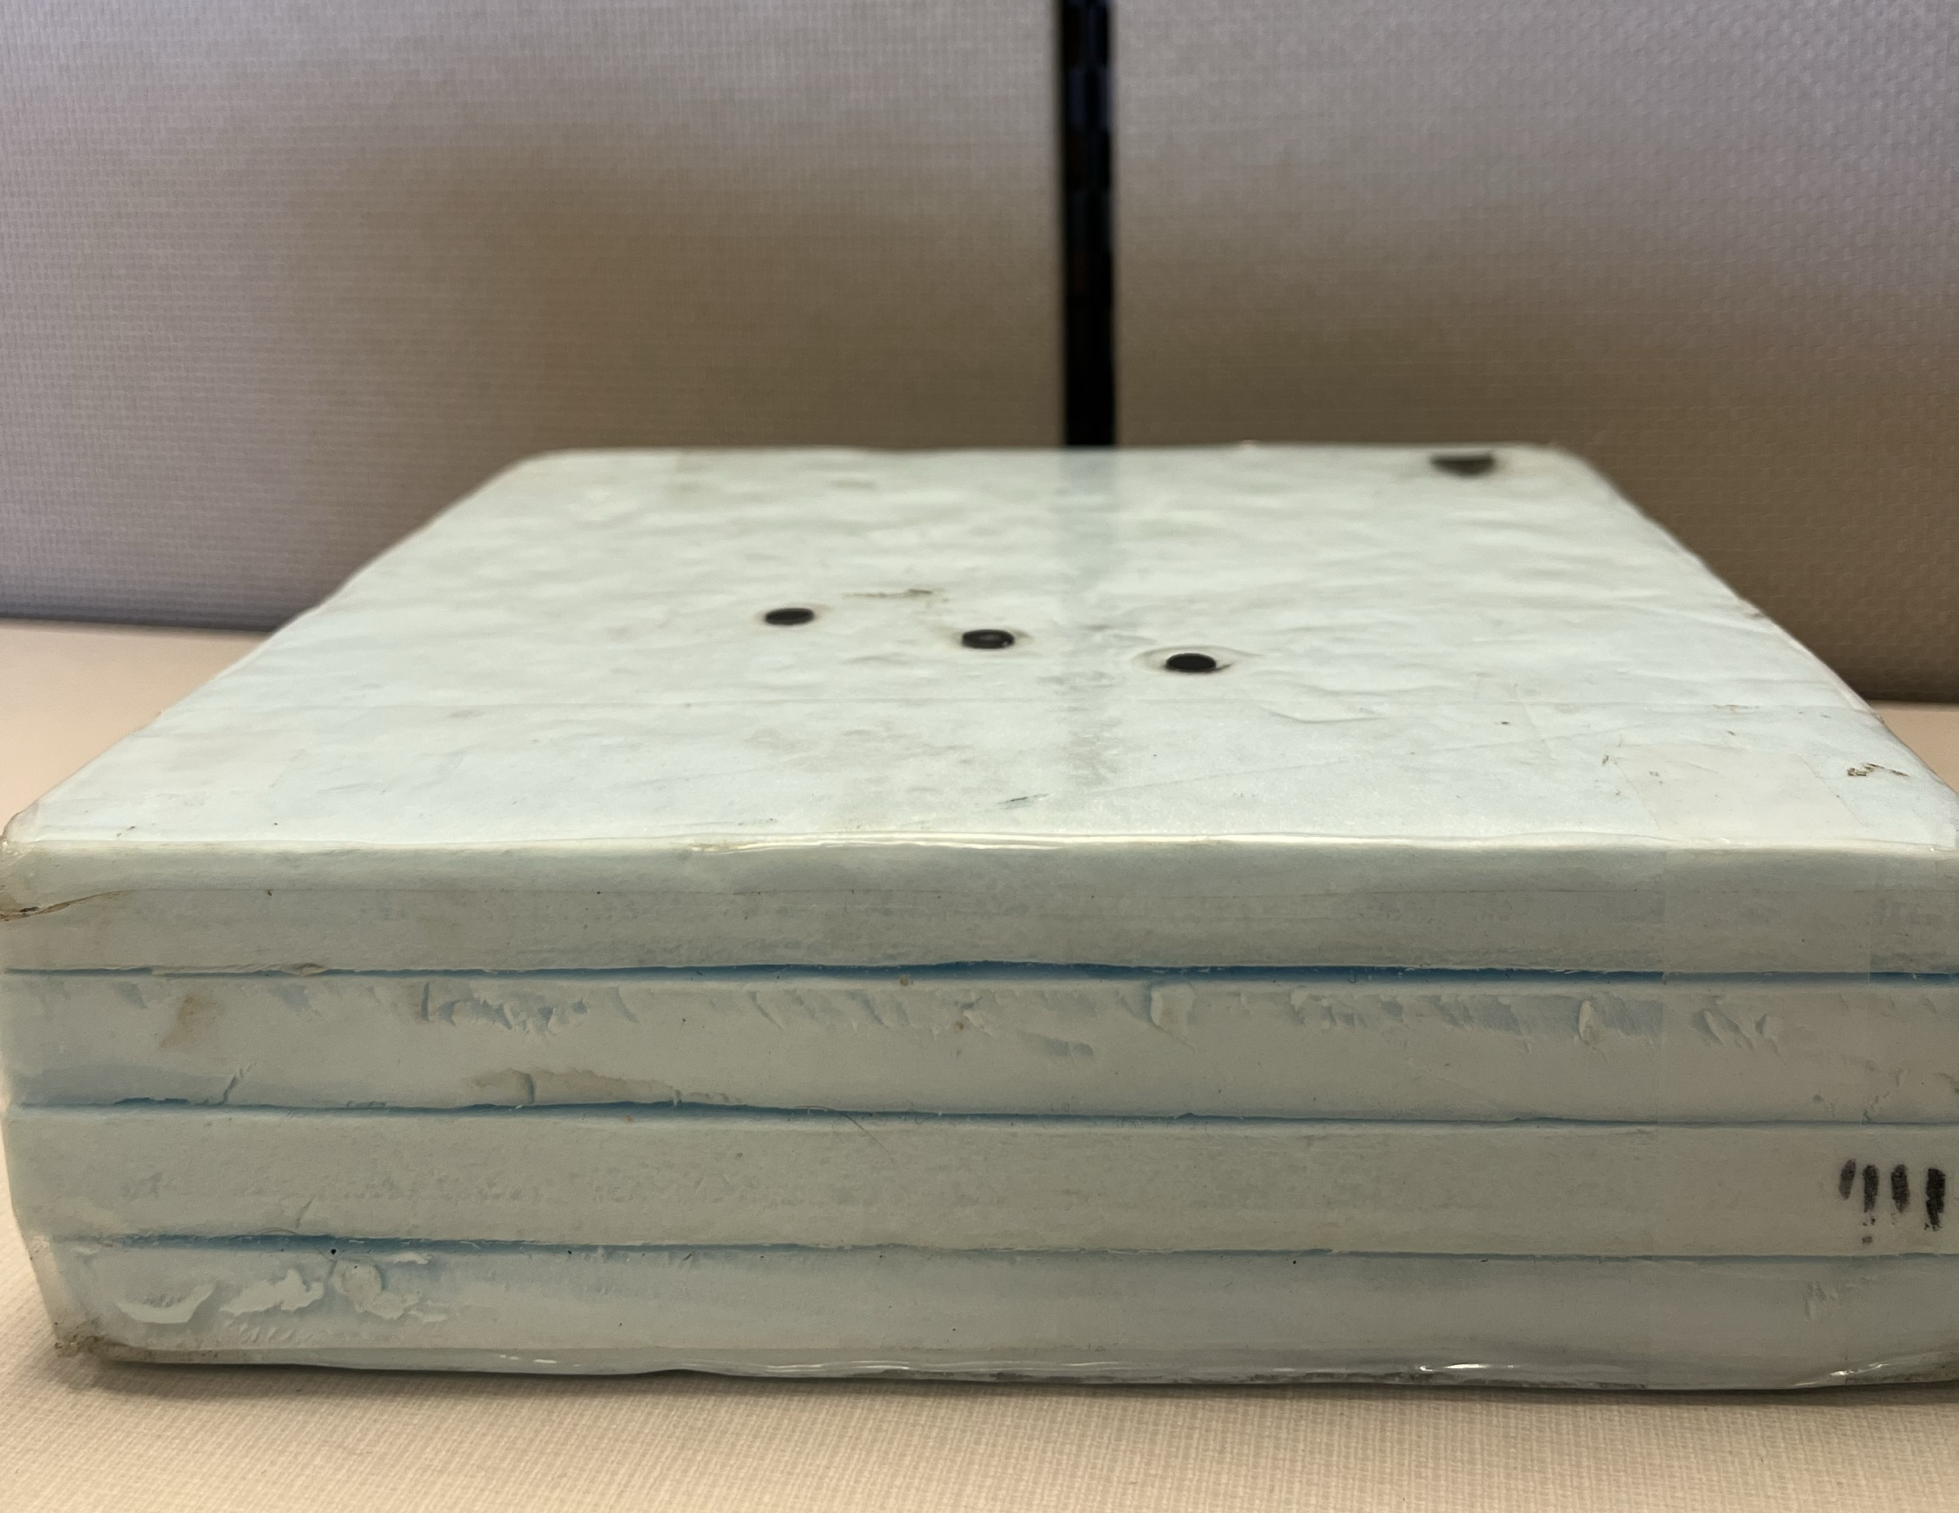
Test Results
RF board:
Imaged the foam object with nine rubber targets at different depths at the CNDE to see the object structure, using the RF board and the DAQ.
15

Slide 17
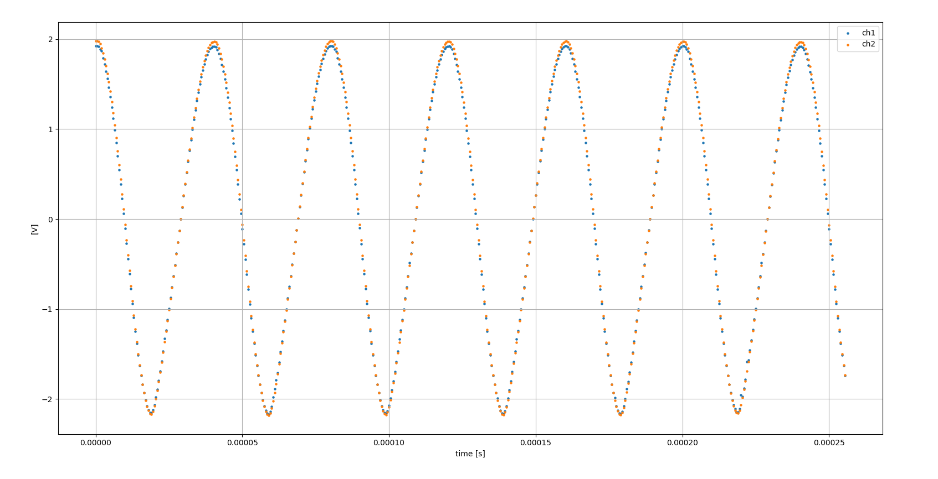
Test Results (cont.)
ADC:
Tested with ADC sampling at 2MS per second. Input signal: 25KHz @ 200mVpp. The gain is G= 20V/V.
16

Slide 18
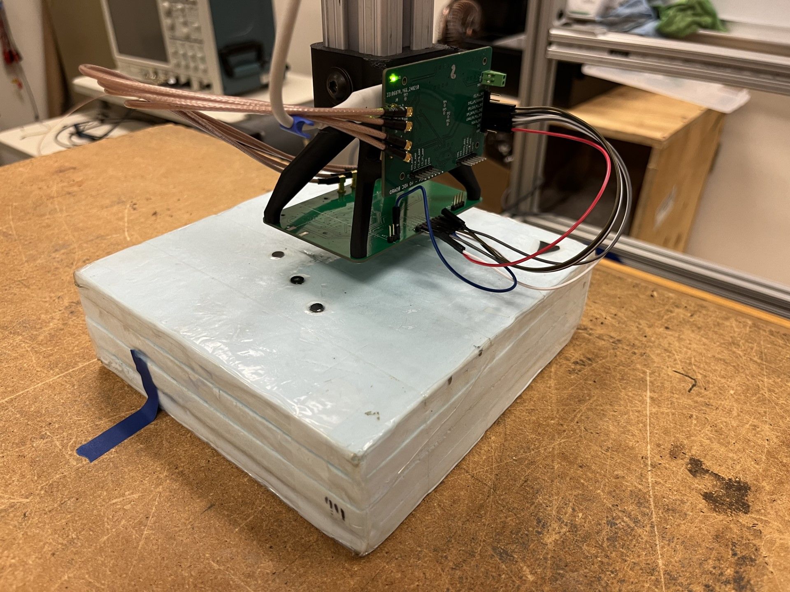
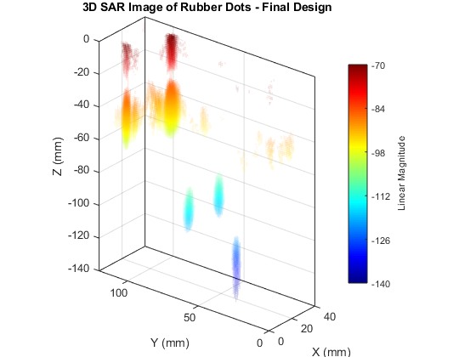
Test Result (cont.)
Conduct object imaging with the RF board and ADC board.
Using SAR method to recreate the object structure.
17

Slide 19
Test Results (cont.)
Acceptance Testing:
Integrate the system as a whole (ADC board with RF board and the Alchitry Au) with the GUI to detect the object’s distance. The expected distance is 20 cm. The measured distance is 19.5 cm.
18

Slide 20
Project challenges
Not enough time to program the Raspberry Pi to host the webserver.
It took a lot of time and effort to learn and implement the hardware coding of the Alchitry Au.
The ADC board had some issue with programming the ADC correctly and noise.
Difficulty learning Django web app framework in enough detail to create built out app in a short period of time.
19

Slide 21
Questions and Answers

